Slide 1
Windows kernel attacks, protections and bypass
Patrice Siracusa – 2025

Slide 2
Ransomware attacks must disable security tools like antivirus & EDR and the only way is to execute malicious code inside Windows kernel through the use of drivers (BYOVD, Bring Your Own Vulnerable Driver).
Microsoft has deployed over time a considerable arsenal in order to put an end to this type of attack, we will see a brief overview of all the following technologies and acronyms :
Vulnerable Driver Blocklist, SMEP, HVCI (VBS), PTE/EPTE, MBEC/RUM, KASRL, KCFG, KCET, PatchGuard (KPP)
Windows kernel attacks protections

Slide 3

A first solution is to blacklist well known drivers used for ransomware attacks : https://learn.microsoft.com/en-us/windows/security/application-security/application-control/app-control-for-business/design/microsoft-recommended-driver-block-rules
- Available though Windows Security GUI
- First introduction in an optional feature Windows 10 1809
- Enabled by default starting Windows 11 22H2
- Automaticaly set if HCVI is actived
The blocklist is updated with each new major release of Windows, typically 1-2 times per year.
The most current blocklist is now also available as an optional update from Windows Update. https://aka.ms/VulnerableDriverBlockList
Vulnerable Driver Blocklist

Slide 4
Execute malicious code inside Windows kernel but to do what ?
1) Privilege escalation, steal SYSTEM token
- The exploit (which usually is a medium-integrity process if executed locally) uses a kernel vulnerability to read and write kernel memory.
- The exploit uses the ability to read/write to overwrite a function pointer in kernel-mode (or finds some other way) to force the kernel to redirect execution into attacker-controlled memory.
- The attacker-controlled memory contains shellcode.
- The attacker-supplied shellcode and perform token stealing in order to escalate to NT AUTHORITY\SYSTEM
2) Call kernel-mode API -> usually harder but more powerful, not limited to token stealing
- Unload or kill any security driver AV, EDR
- Disable kernel hooks and monitoring
Kernel exploitation

Slide 5
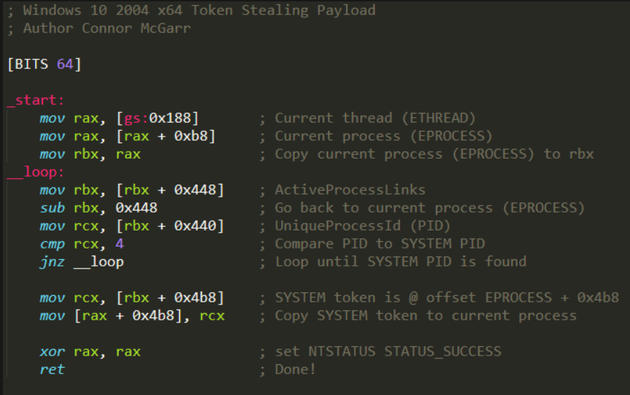
Privilege escalation, steal SYSTEM token example

Slide 6
ASLR : Address Space Layout Randomization : it’s a technique aimed at preventing an attacker who previously knows that a program function is vulnerable and can be exploited, to get access to it by preventing him from knowing the memory address where that function is allocated within the running process.
This is possible because ASLR basically consists of randomly distributing the fundamental parts of a process (executable base, stack pointers, libraries, etc.) into the memory address space that has been assigned to it by the operating system.
ASRL is a software-based solution and an option at compilation time for applications.
Windows randomizes libraries usually only once – at system boot time – in order to reduce the performance cost of the ASLR exploit mitigation.
Only a system reboot will guarantee new base addresses.
KASLR : only randomizes the kernels base address once at boot time
KASLR is enabled by default (first introduced with Vista and improved over time)
ASLR, KASLR

Slide 7
https://learn.microsoft.com/en-us/windows/win32/secbp/control-flow-guard
Control Flow Guard (CFG) is a highly-optimized platform security feature that was created to combat memory corruption vulnerabilities.
By placing tight restrictions on where an application can execute code from, it makes it much harder for exploits to execute arbitrary code through vulnerabilities such as buffer overflows.
CFG is a software-based solution and an option at compilation time for applications.
CFG extends previous exploit mitigation technologies such as /GS (Buffer Security Check), Data Execution Prevention (DEP), and Address Space Layout Randomization (ASLR).
KCFG is enabled by default (first introduced with Windows 8 and improved over time)
CFG, KCFG

Slide 8
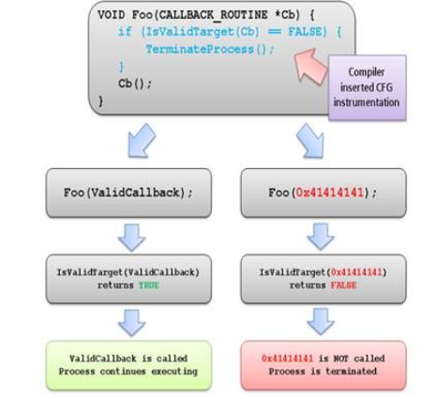
CFG

Slide 9
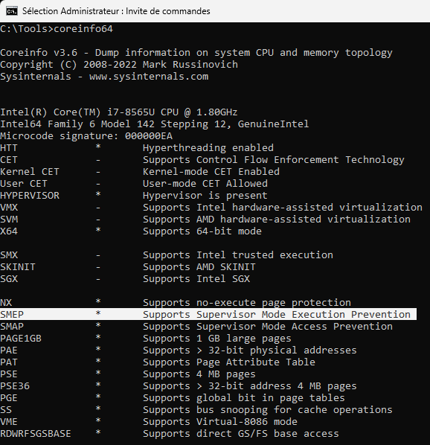
https://connormcgarr.github.io/x64-Kernel-Shellcode-Revisited-and-SMEP-Bypass
First implementation in Windows 8
SMEP is a prevention that does not allow execute user mode code (ring 3) from kernel mode (ring 0)
SMEP is a hardware-based solution enabled via the CR4 CPU register (20th bit)
Check SMEP support with coreinfo tool.
SMEP (Supervision Mode Execution Prevention)

Slide 10
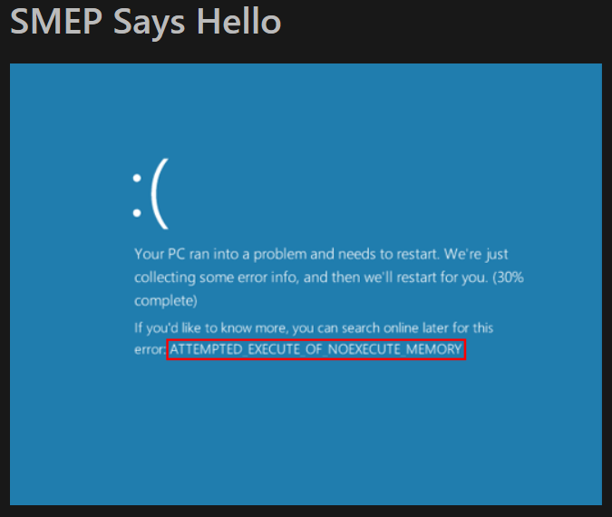
SMEP (Supervision Mode Exécution Prevention)

Slide 11
2 well-known techniques :
- Disable SMEP using ROP
- Bypass SMEP via PTE (Page Table Entry) overwrite (set supervisor flag to shellcode page)
SMEP Bypass

Slide 12
ROP assumes we have control over the stack (as each ROP gadget returns back to the stack)
ROP gagdets will need to come from kernel mode pages.
------------------- pop <reg> ; ret
-------------------
VALUE_WANTED_IN_CR4 (0x506f8) - This can be our own user supplied value.
------------------- mov cr4, <reg> ; ret
-------------------
SMEP is now disabled - User mode payload address
Disable SMEP using ROP

Slide 13
ROP requirements needs kernel base address (ROP gadgets are only offsets from base address).
Leak ntoskrnl.exe (kernel base) - which bypasses KASLR – using well known functions :
EnumDeviceDrivers
NtQuerySystemInformation
Windows 11 24H2, SeDebugPrivilege is now required to call these functions
Another technique to guess kernel base address (KASRL) is to use Time Caching (no need SeDebugPrivilege), but only work on real hardware : https://r0keb.github.io/posts/Bypassing-kASLR-via-Cache-Timing
Disable SMEP using ROP (requirements)

Slide 14
https://www.blackhat.com/docs/us-17/wednesday/us-17-Schenk-Taking-Windows-10-Kernel-Exploitation-To-The-Next-Level%E2%80%93Leveraging-Write-What-Where-Vulnerabilities-In-Creators-Update.pdf
- Obtain read/write primitive
- Leak ntoskrnl.exe (kernel base) – bypass kASLR
- Locate MiGetPteAddress() (can be done dynamically instead of static offsets)
- Use PTE base to obtain PTE of any memory page
- Change bit (flipping U/S bit of a user mode page)
SMEP bypass via PTE overwrite

Slide 15
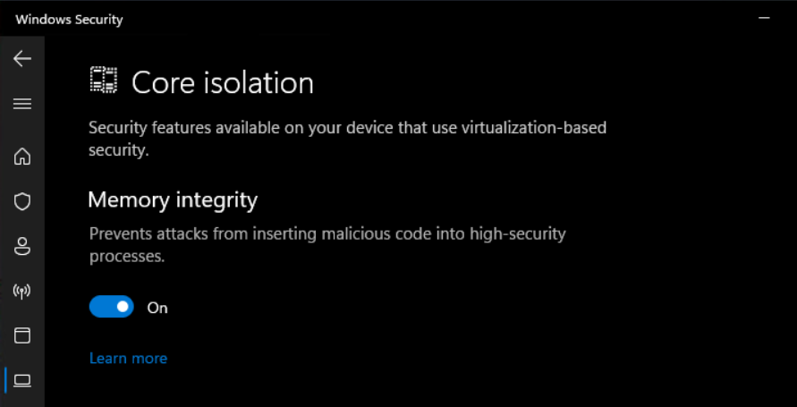
Windows Hypervisor-Protected Code Integrity (HVCI)
First introduced with Windows 10

Slide 16
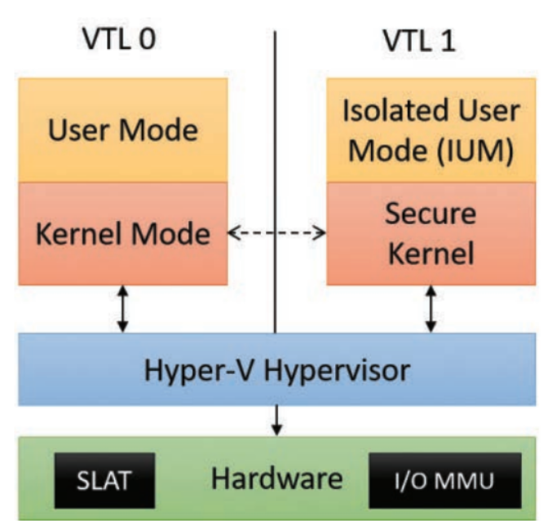
HVCI

Slide 17
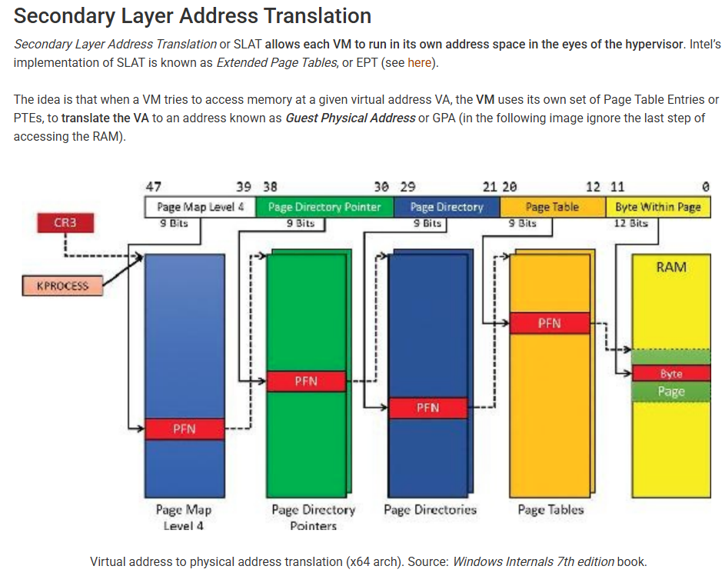
HVCI

Slide 18
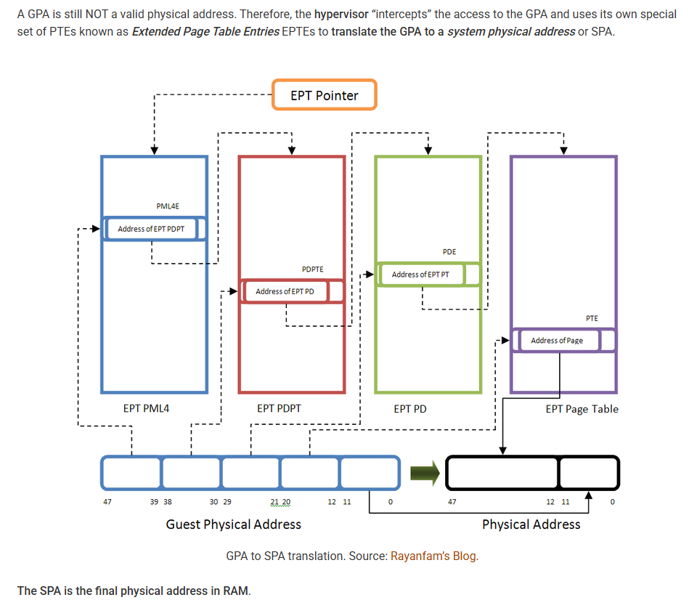
HVCI

Slide 19
EPTEs still rely on the CPU to enforce security.
Anytime execution is in the kernel on Windows, all of the user-mode pages as non-executable.
It’s a hardware based solution, MBEC (Mode-Based Execution Control).
For CPUs that cannot support MBEC Microsoft has its own emulation of MBEC called Restricted User Mode, or RUM
Conclusion :
- PTE / EPTE manipulation to achieve unsigned-code execution is impossible.
- ROP is still a viable solution to achieve kernel API exploit.
- HVCI not activated by default.
HVCI

Slide 20
https://connormcgarr.github.io/hvci
How to call any kernel API without trigering HVCI (it’s not an HVCI bypass) ?
- Create a “dummy” thread in a suspended state via CreateThread.
- Assuming our exploit is running from a “normal” process (running in medium integrity), we can use NtQuerySystemInformation to leak the KTHREAD object associated with the suspended thread. From here we can leak KTHREAD.StackBase - which would give us the address of the kernel-mode stack in order to write to it (each thread has its own stack, and stack control is a must for a ROP chain)
- We can locate a return address on the stack and corrupt it with our first ROP gadget, using our kernel arbitrary write vulnerability (this gets around kCFG, or Control Flow Guard in the kernel, since kCFG doesn’t inspect backwards edge control-flow transfers like ret.
- We then can use our ROP chain in order to call an arbitrary kernel-mode API. After we have called our intended kernel mode API(s), we then end our ROP chain with a call to the kernel-mode function nt!ZwTerminateThread - which allows us to “gracefully” exit our “dummy” thread without needing to use ROP to restore the execution we hijacked.
- We then call ResumeThread on the suspended thread in order to kick off execution
HVCI bypass

Slide 21
https://learn.microsoft.com/en-us/windows-server/security/kernel-mode-hardware-stack-protection https://windows-internals.com/cet-on-windows
Kernel-mode Hardware-enforced Stack Protection is off by default
Requirements :
- Available in Windows 11 2022 update or newer
- Hardware that supports Intel Control-flow Enforcement Technology (CET) or AMD Shadow Stacks
- Virtualization-based security (VBS) and Hypervisor-enforced code integrity (HVCI) are enabled.
ROP technique is dead with CET and KCET activated !
How it works ?
RIP ROP with CET and KCET (Shadow Stack)

Slide 22
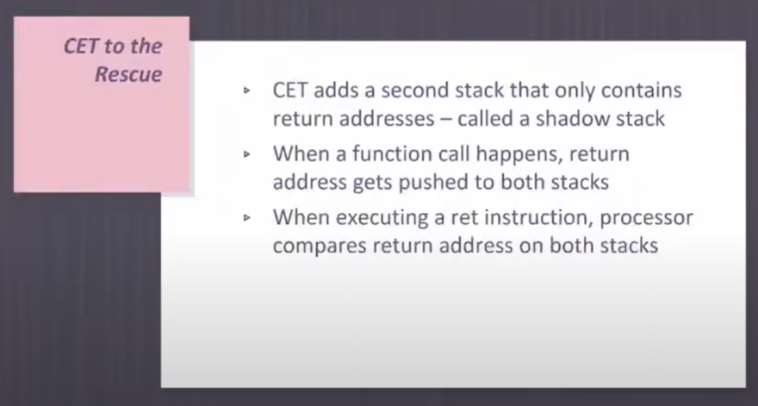
https://www.youtube.com/watch?v=jJfbFj_-ses
RIP ROP : CET and KCET (Shadow Stack)

Slide 23
https://r0keb.github.io/posts/PatchGuard-Internals
PatchGuard or KPP is a mitigation introduced in 2005 in the 64bit versions of Windows Vista and Server 2003.
Its main purpose is to inspect critical kernel structures and code to ensure they haven’t been tampered with.
If it detects any unwanted modification, it will trigger a BSOD with the error code CRITICAL_STRUCTURE_CORRUPTION
Kernel PatchGuard (KPP)

Slide 24
Kernel exploitation (and exploitation in general) on Windows is becoming harder with every new version.
Driver Signature Enforcement made it harder for an attacker to load unsigned drivers, and later HVCI made it entirely impossible – with the added difficulty of a driver block list, preventing attackers from loading signed vulnerable drivers.
SMEP and KCFG mitigate against code redirection through function pointer overwrites, and KCET makes ROP impossible as well.
And on top of those, there are Patch Guard and Secure Kernel Patch Guard which validate the integrity of the kernel and many of its components.
However don’t forget :
- Somes of these features are not enabled by default (HVCI) and hardware dependent (SMEP, HVCI, CET)
- At the time of writing there’s still one technique that requires only an arbitrary kernel write primitive
The end of kernel exploitation ?

Slide 25
https://windows-internals.com/one-i-o-ring-to-rule-them-all-a-full-read-write-exploit-primitive-on-windows-11
Data-based attacks are still a viable solution.
A known technique for a data-only attack is to create a fake kernel-mode structure in user mode, then tricking the kernel to use it through a write-what-where bug.
The kernel will treat this structure like valid kernel data, allowing the attacker to achieve privilege escalation by manipulating the data in the structure, thus manipulating kernel actions that are done based on that data
With a single arbitrary write and a fake buffer array we can get full control of the kernel address space through read and write operations.
Kernel data-based attacks

Slide 26
1. Create two named pipes with CreateNamedPipe: one will be used for input for arbitrary kernel writes and the other for output for arbitrary kernel reads. At least the pipe that’ll be used as input should be created with flag PIPE_ACCESS_DUPLEX to allow both reading and writing.
2. Open client handles for both pipes with CreateFile, both with read and write permissions.
3. Create an I/O ring: this can be done through CreateIoRing API.
4. Allocate a fake buffers array in the heap: Starting from the official 22H2 release, the registered buffers array is no longer a flat array, but an array of IOP_MC_BUFFER_ENTRY structures, so this gets slightly more tricky.
5. Find the address of the newly created I/O ring object: since I/O rings use a new object type, IORING_OBJECT, we can leak its address through a well-known KASLR bypass technique. NtQuerySystemInformation with SystemHandleInformation leaks the kernel addresses of objects, including our new I/O ring object. Fortunately, the internal structure of IORING_OBJECT is in the public symbols so there’s no need to reverse engineer the structure to find the offset of RegBuffers. We add the two together to get the target for our arbitrary write.
Unfortunately, this API as well as many other KASLR bypasses can only be used by processes with Medium IL or higher
6. Use your preferred arbitrary write bug to overwrite IoRing->RegBuffers with the address of the fake user-mode array. Notice that if you haven’t previously registered a valid buffers array you’ll also have to overwrite IoRing->RegBuffersCount to have a non-zero value.
7. Populate the fake buffers array with kernel pointers to read or write to: to do this you might need other KASLR bypasses in order to find your target addresses. You could use NtQuerySystemInformation with SystemModuleInformation class to find the base addresses of kernel modules, use the same technique as earlier to find kernel addresses of objects, or use the pointers available inside the I/O ring itself, which point to data structures in the paged pool.
8. Queue read and write operations in the I/O ring through BuildIoRingReadFile and BuildIoRingWriteFile.
Kernel data-based attacks using I/O Ring

